Slide 1
June 5, 2019

Slide 2
Agenda
Introduction
Travel & Growth Patterns
2030 Baseline & Concepts
Key Takeaways
Questions
Notes:
County

Slide 3
Introduction

Slide 4
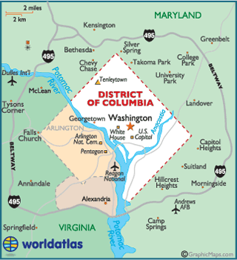
Study Area
Notes:
- Modeling Context Area - the broadest boundary for the study area which includes some of the regional connections and travel patterns
- Operational Analysis Area - Focused area for traffic analyses
- Core Street Reconfiguration Area - concentrated area in which street network reconfiguration alternatives will be proposed. This area will have the most detailed multimodal analysis.
- Critical Intersections – intersection that are vital to the multimodal mobility of the Rosslyn core. Pedestrian and bicycle operational data will be analyzed for these intersections

Slide 5
From Sector Plan to Core Study
Sector Plan
Adoption 2015
Long-Term: Core Study
April 2018
Public Kick Off & Data Workshop
2018-2019
Core Study Development & Public Workshops
Summer 2019
Final Study Recommendations & Next Steps
VISION
“Balance among all travel modes to meet transportation needs and support Rosslyn’s growth”
STUDY
IMPLEMENTATION
Design
Public Input
Analysis
Notes:
County

Slide 6
Goals
Analyze multimodal transportation conditions and needs
Engage the public and stakeholders in the analysis process
Evaluate concepts for street network design to achieve the Sector Plan’s objectives
Arrive at a final alternative concept (set of projects) to move through the County’s design process
Notes:
County

Slide 7
Transportation Study Focus Areas
Transit
Economic Development
Align with Sector Plan goals
Used to develop performance measures:
Allow for comparative assessment between baseline and concepts
Pedestrians
Urban Design
Bicycles
Curb Space
Vehicles
Notes:
Focus Areas
- Centered around implementation
Differences between existing and baseline
Tradeoffs between elements/modes

Slide 8
Key Data and Model Assumptions
 | Use
Existing Data Counts, StreetLight, Parking, Surveys, Google API | Balanced volumes Travel patterns Mode share Garage access
MWCOG Travel Demand Forecasting Model | Version 2.3.70 Regional vehicular trips/growth patterns (relative to Rosslyn) Review mode share
VISUM Subarea Model | O-D matrix estimation for 2017 Reassigning ITE-based vehicular trips in 2030 High-level concept screening
VISSIM Models | Evaluating multimodal traffic operations and reporting performance measures
Notes:
Note that 2016 base year was used for COG model due to I-66 ITB being tolled in 2017 base year in 2.3.70
Base VISUM and VISSIM 2017
Visum subarea – key to growth of trip tables (I/E, E/E..)
Round 9.1 Cooperative forecasts for Arlington County only (updated input SE data file only for Arlington); 9.0 forecasts for other jurisdictions

Slide 9
Travel & Growth Patterns

Slide 10
Rosslyn Mode Share: Residents
FROM
ROSSLYN
Rosslyn’s public transit and active mode shares are almost double that of the County as a whole
Accommodating public transit and active modes is critical in Rosslyn
Source: American Community Survey commuting data (2011-2015) for two census tracts generally representing Study Area
Notes:
Transit = 47% Rosslyn / 26% County
Walk + Bike = 10% Rosslyn / 6.6 County

Slide 11
Rosslyn Mode Share: Employees
TO
ROSSLYN
Almost equivalent percentages of drive alone and public transit trips
Public transit is a vital link for commuters who work in Rosslyn
Source: Arlington County Building Survey (2016) for buildings in the Rosslyn Study Area

Slide 12
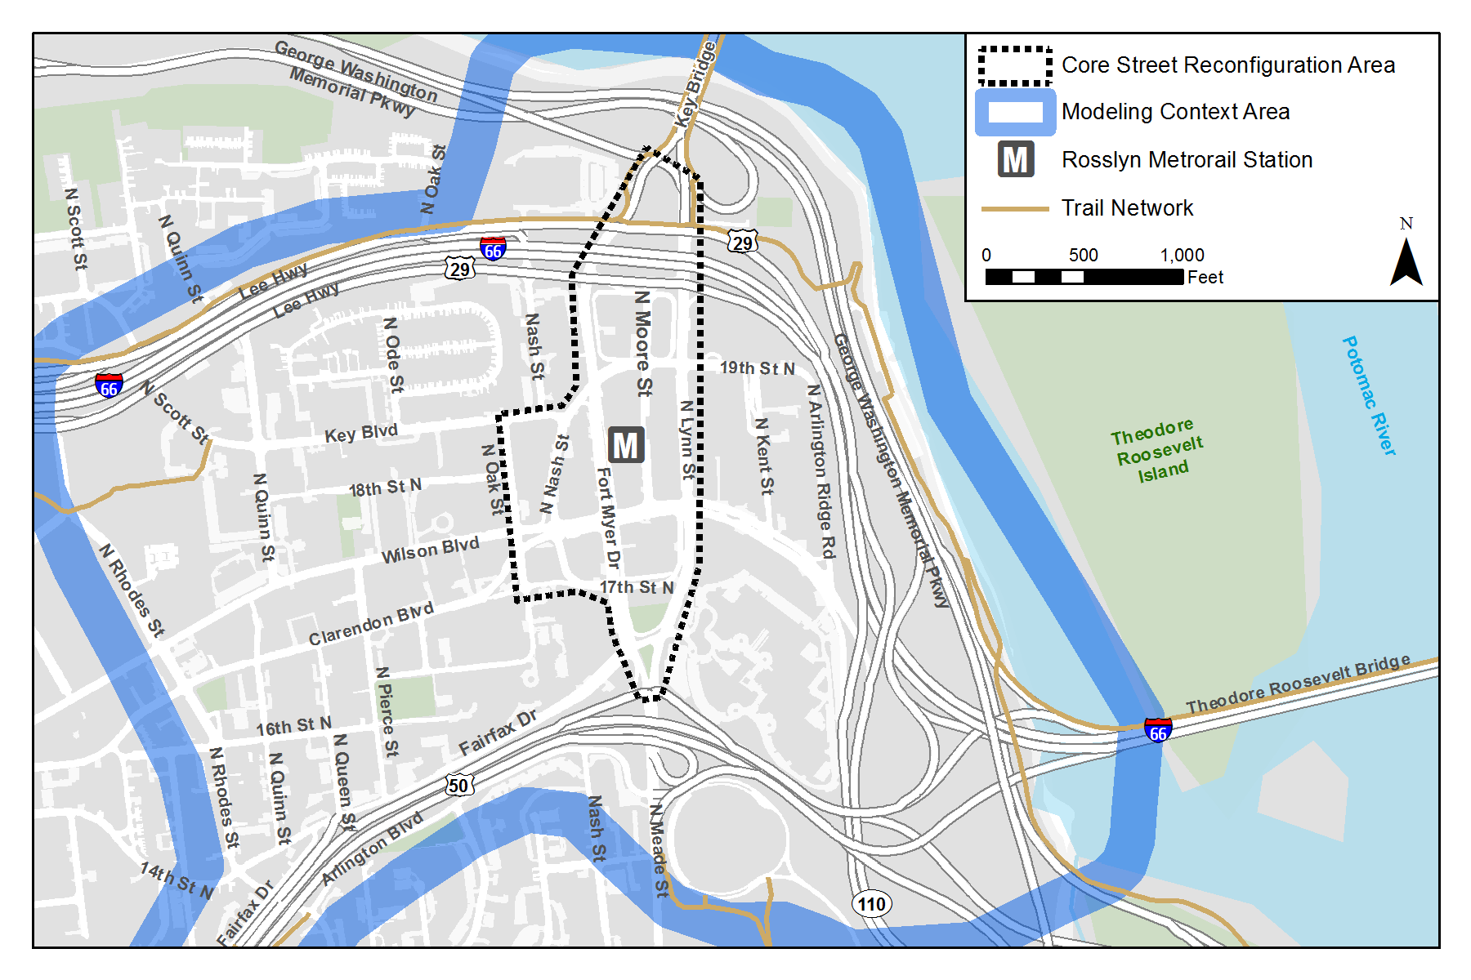
Regional Gateway
80% of peak period vehicle trips in/through Rosslyn are through trips
Source: MWCOG regional travel forecast model and StreetLight origin-destination data
Notes:
Trips within the modeling context area (blue boundary)

Slide 13
Existing Traffic Conditions
Peak Period speeds as a percentage of posted speed.
AM Peak:
7-10AM
PM Peak:
3:30-6:30PM

Slide 14
Development and Growth in Rosslyn
Estimated from 2015 to 2030:
42% Population Growth; 34% Employment Growth
13% Auto Trip Growth; 57% Non-Auto Trip Growth
MORE TRIPS
MORE PEOPLE
Estimated Number of PM Peak Period Trips
Source: Arlington County, CPHD, Planning Division, Center for Urban Design and Research, Dec 2017.
Sources: Institute of Transportation Engineers (ITE) Trip Generation Model (10th Edition), MWCOG Version 2.3.7 Travel Demand Model with Round 9.1 cooperative forecasts for Arlington County
Notes:
Population grows by 42 percent
Employment by 34 percent
Employees per Resident:
2015: 2.2
2030: 2.1
We can discuss where in Rosslyn the biggest gains in employment and population will occur
in 2015-
6 percent of the County’s population live in Rosslyn
14 percent of employment in the County is located is Rosslyn
By 2030-
7 percent of the County’s population live in Rosslyn
17 percent of employment in the County is located is Rosslyn

Slide 15
2030 Baseline & Concepts

Slide 16
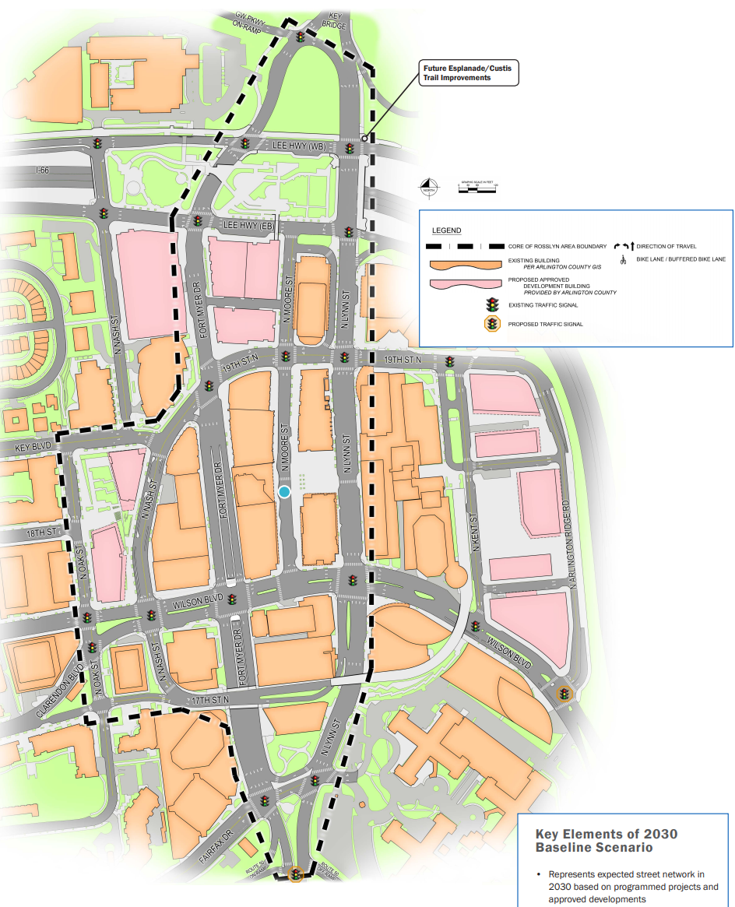
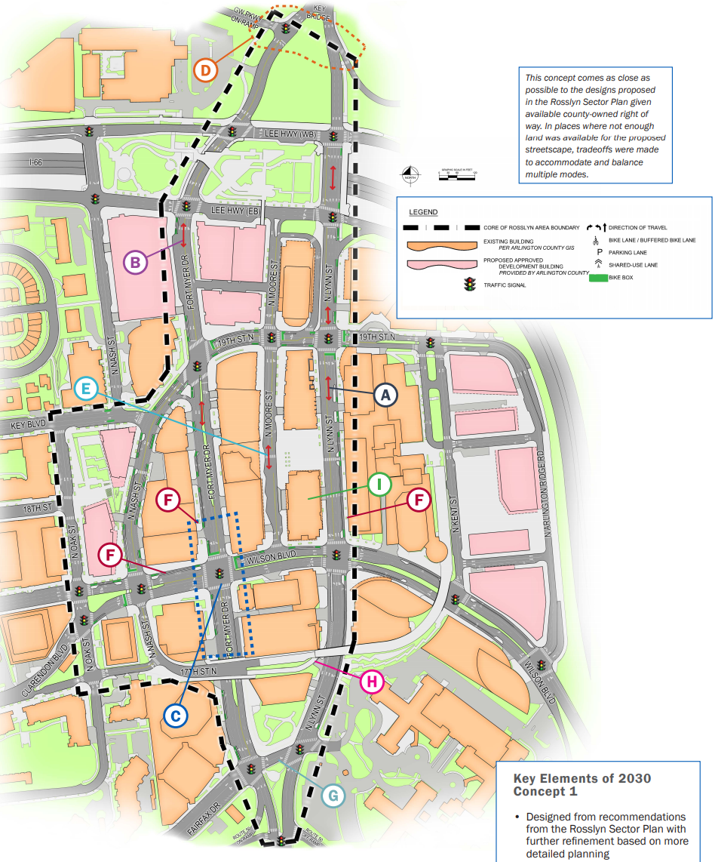
Changes to GWNP Entrance
Two-Way of
Lynn St
Fort Myer Dr
Moore St
New Bike/Ped Infrastructure
2030 Baseline Scenario
Expected street network based on programmed projects and approved site developments.
2030 Concept 1 Scenario
Designed from the Sector Plan with refinement based on right-of-way. Includes two-way of major streets.
Removal of Slip Lanes

Slide 17
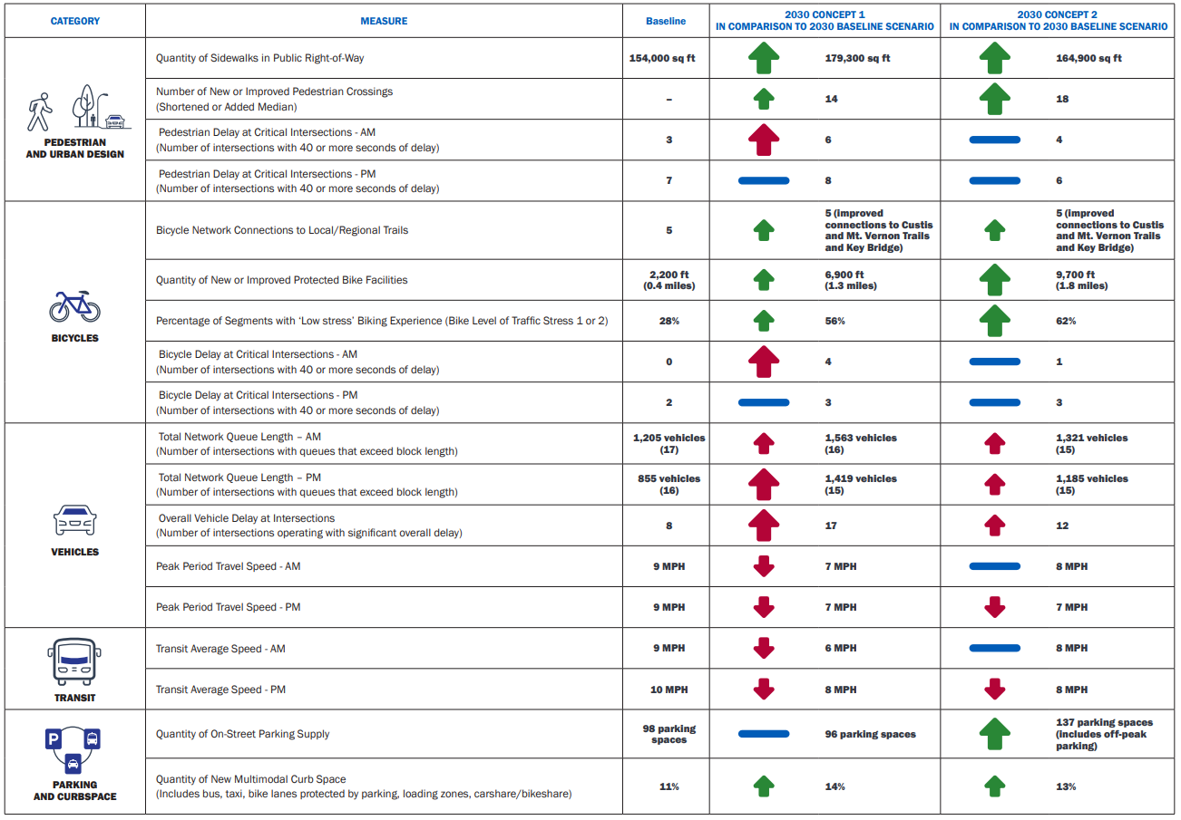
Measures of Effectiveness
Sidewalk Space (sq ft)
New or Improved Crossings (Shortened or Added Median)
Critical Intersections with 40+ Seconds of Delay (AM)
Critical Intersections with 40+ Seconds of Delay (PM)
Connections to Local/Regional Trails
New or Improved Bike Routes (ft)
Percentage of Segments Rated “Low Stress”
Critical Intersections with 40+ Seconds of Delay (AM)
Critical Intersections with 40+ Seconds of Delay (PM)
Total Network Queue Length (AM)
Total Network Queue Length (PM)
Number of Intersections with Significant Delay
Peak Period Travel Speed (AM)
Peak Period Travel Speed (PM)
Transit Average Speed (AM)
Transit Average Speed(PM)
Quantity of On-Street Parking Spaces
Quantity of New Multimodal Curb Space

Slide 18
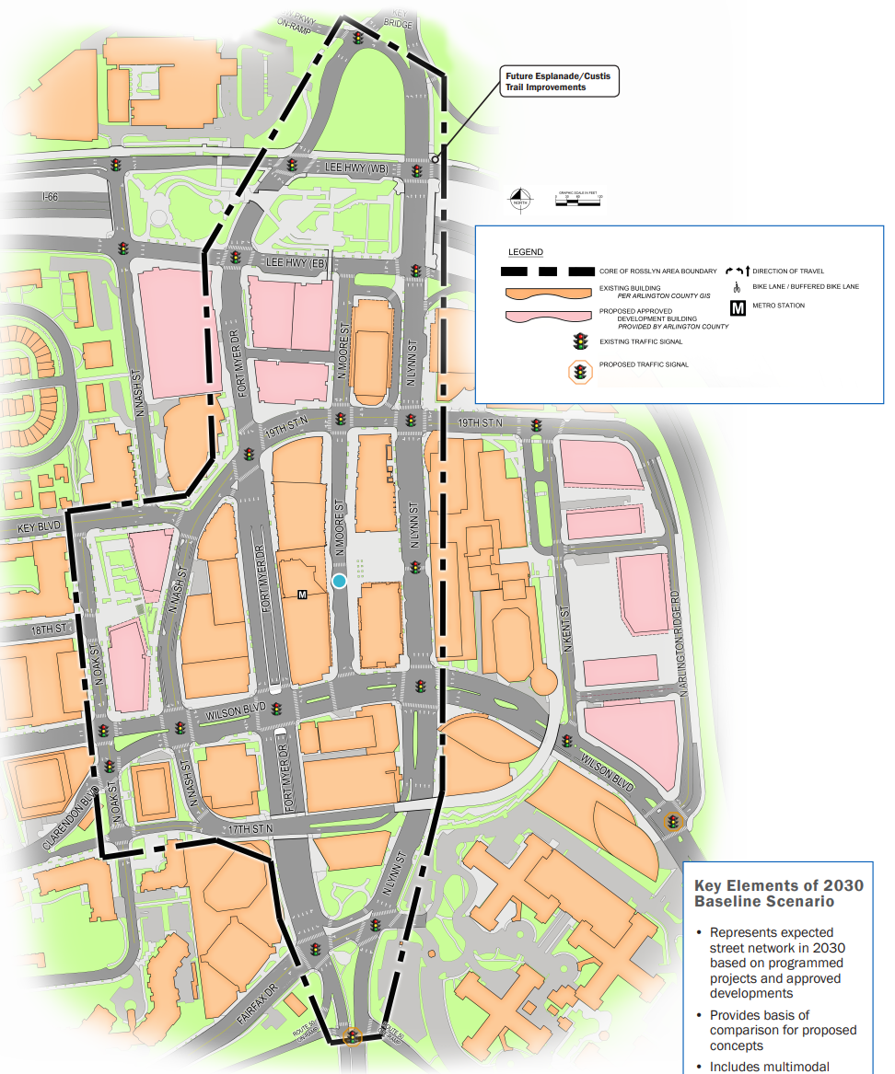
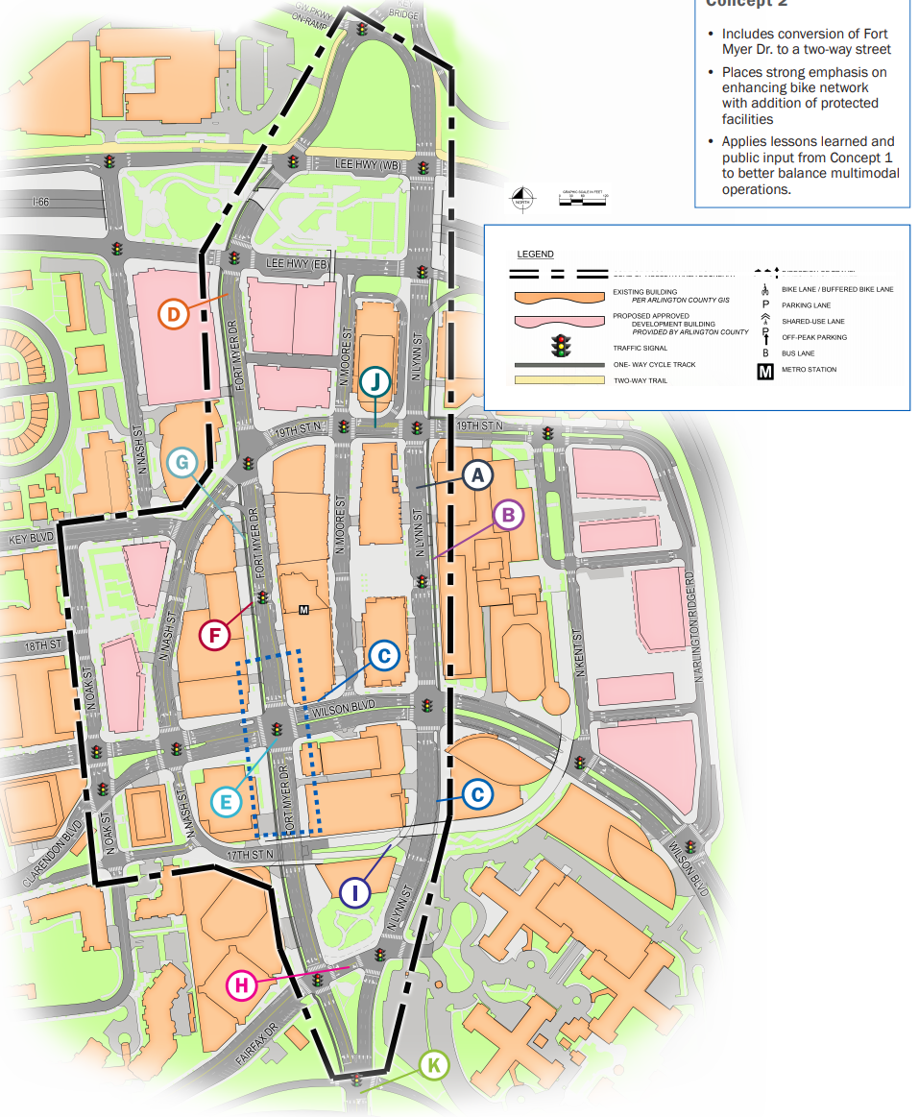
Two-Way of
Fort Myer Dr Only
New Bike/Ped Infrastructure
2030 Baseline Scenario
Expected street network based on programmed projects and approved site developments
2030 Concept 2 Scenario
Designed from lessons learned and public input from the review of
Concept 1 findings
Removal of Slip Lanes

Slide 19
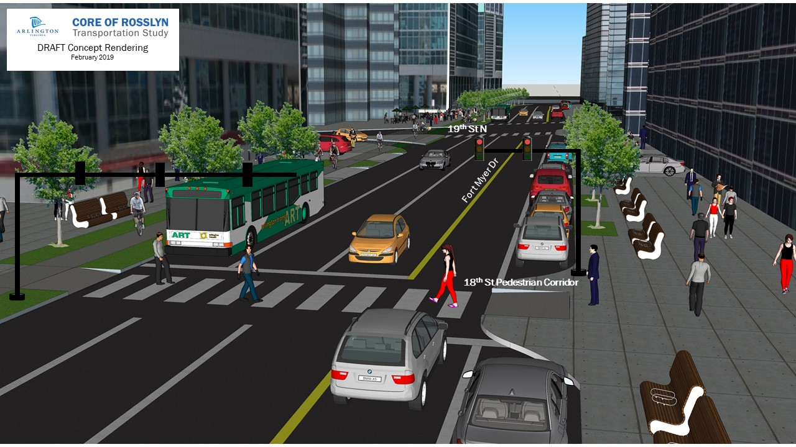

Slide 20
Measures of Effectiveness
Sidewalk Space (sq ft)
New or Improved Crossings (Shortened or Added Median)
Critical Intersections with 40+ Seconds of Delay (AM)
Critical Intersections with 40+ Seconds of Delay (PM)
Connections to Local/Regional Trails
New or Improved Bike Routes (ft)
Percentage of Segments Rated “Low Stress”
Critical Intersections with 40+ Seconds of Delay (AM)
Critical Intersections with 40+ Seconds of Delay (PM)
Total Network Queue Length (AM)
Total Network Queue Length (PM)
Number of Intersections with Significant Delay
Peak Period Travel Speed (AM)
Peak Period Travel Speed (PM)
Transit Average Speed (AM)
Transit Average Speed(PM)
Quantity of On-Street Parking Spaces
Quantity of New Multimodal Curb Space

Slide 21
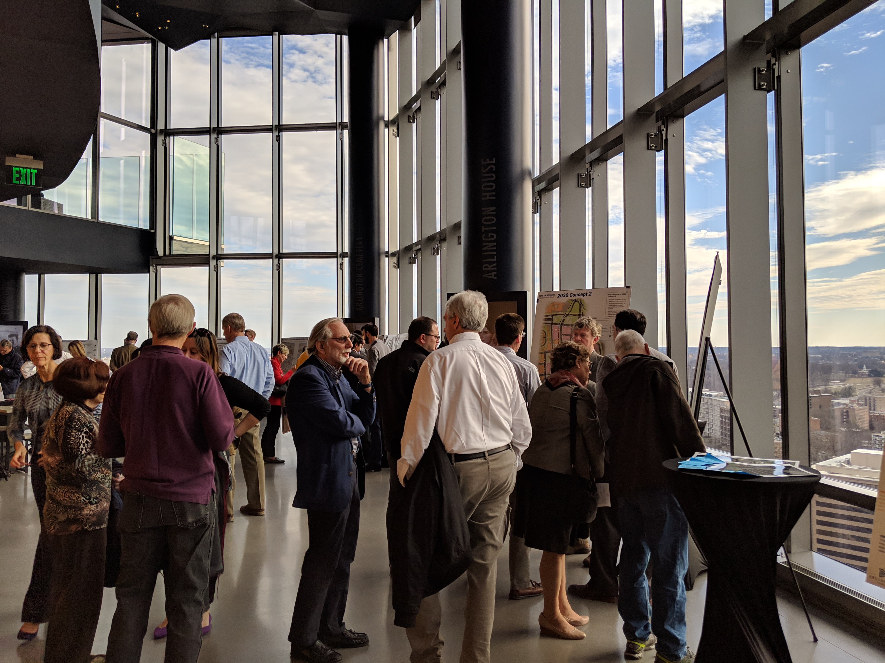
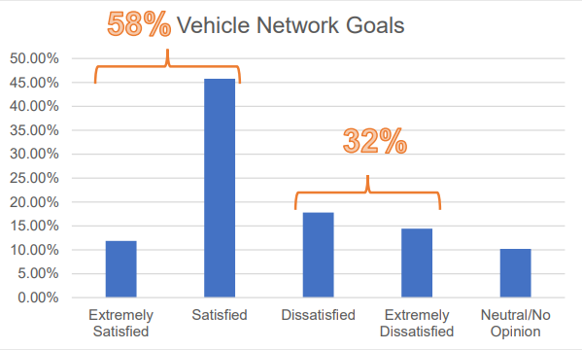
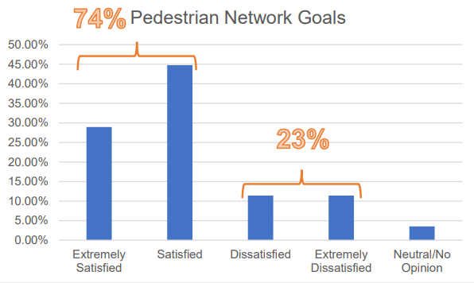
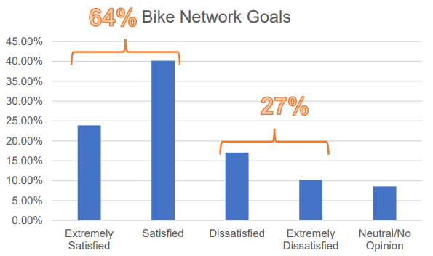
Public Response
Notes:
County

Slide 22
Key Takeaways

Slide 23
Key Takeaways
Performance-based planning
An iterative process of analysis, design, and public engagement to arrive at a balanced street network concept for all users
Develop multimodal performance measures that allow for comparative assessment between baseline conditions and concepts
Qualitative and quantitative analysis
A lens of regional and local perspective
Data and modeling help inform public and stakeholders of needs and conditions

Slide 24
Arlington County Department of Environmental Services
Christine Sherman Baker, AICP – Principal Planner csherman@arlingtonva.us
https://projects.arlingtonva.us/projects/core-rosslyn-transportation-study/

